Slide 1
ELEMENTARY STATISTICS, BLUMAN
Central Limit Theorem Example 2
© 2019 McGraw-Hill Education. All rights reserved. Authorized only for instructor use in the classroom. No reproduction or further distribution permitted without the prior written consent of McGraw-Hill Education.

Slide 2
Objectives for this PowerPoint
Calculate a probability associated with a sample using the Central Limit Theorem

Slide 3
Problem
In 2013, a Nielsen poll showed that among people age 13 and older who play video games, the average time spent per week playing is 6.3 hours per week. Assume a standard deviation of 1.9 hours per week. If a random sample of 40 people who play video games were drawn in 2013, what is the probability that the mean hours spent playing video games for the sample would be greater than 7.1 hours?

Slide 4
What is the Exact Question?
We must pay particular attention to the exact question that is being asked. We are not asked to find a probability associated with a single value. Rather, we are asked to find a probability associated with a sample of size 40.
In order to answer this question, we must first understand the Central Limit Theorem. The Central Limit Theorem states that as the sample size increases without limit the shape of the distribution of the sample means will approach a normal distribution.

Slide 5
Central Limit Theorem
It is important to remember two things when using the Central Limit Theorem.
If the population is normally distributed then the sampling distribution will be normally distributed regardless of sample size.
If the population is not normally distributed then the sampling distribution is approximately normally distributed if the sample size is at least 30.
The sample size for this problem is 40. So we will use the normal distribution to approximate this probability.

Slide 6

z Score
The question is asking us to find the probability that the sample mean is greater than 7.1 for the sample of 40 people.
$$P(\overline{x}>7.1)$$
We will use a z score to find this probability.
$$z=\frac{\overline{x}−μ}{\frac{σ}{\sqrt{n}}}$$

Slide 7

Find the z Score
It is very important that we use the standard deviation for the sampling distribution also called the standard error of the means when calculating a z score associated with a mean of a sample.
We will substitute the sample mean, population mean, standard deviation, and sample size into the z score formula.
$$z=\frac{\overline{x}−μ}{\frac{σ}{\sqrt{n}}}$$
$$z=\frac{\overline{7.1}−6.3}{\frac{1.9}{\sqrt{40}}}=2.66$$
$P(\overline{x}>7.1)$ is the as P(z > 2.66)

Slide 8
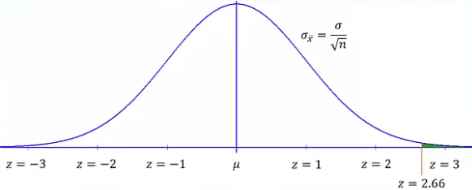
Draw Graph
It is always helpful to draw an appropriately shaded curve when finding probabilities associated with a normal distribution.
Our z score of 2.66 will be between z = 2 and z = 3.
We are to find the probability that the z score would exceed 2.66. We will shade the region under the normal curve to the right of 2.66.

Slide 9
Use Table or Calculator to Find Probability
Using a tool such as a normal probability table or a graphing calculator. We would find that the proportion of the distribution occupied by that shaded area is 0.0039.
The probability that the z score would be greater than 2.66 is 0.0039.
Another way to state this result is by saying in the year 2013, among people who played video games 0.39% of all possible samples of size 40 would have a mean number of hours spent playing per week greater than 7.1 hours.

Slide 10
Summary
In this PowerPoint, we learned how to calculate a probability associated with a sample using the Central Limit Theorem.

